Slide 1
NESTJS CRUD API
Introduction Fundamental Concepts and Basics API Development and Enhancements Backend Implementation and Integration Project Outcomes and Learnings

Slide 2
1. Introduction
Purpose of the Project:
Showcase a CRUD API using NestJS.
Objective:
Learn the fundamentals of NestJS, API development, and integration with frontend technologies.
Overview:
The project implements a backend API with CRUD functionality, focusing on scalability, modularity, and clean code practices.

Slide 3
2. Fundamental Concepts and Basics
NestJS Overview:
Introduction to the framework, modular architecture, and dependency injection.
Project Structure:
Explanation of
Modules
controllers
services
entities
Core Features Used:
DTOs (Data Transfer Objects), validation pipes, decorators, and middleware.

Slide 4
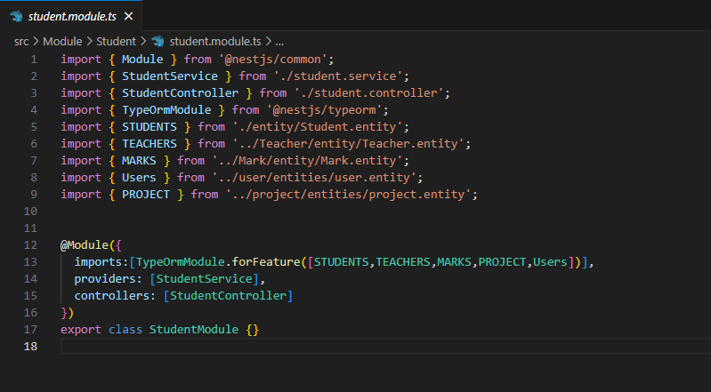
Modules

Slide 5
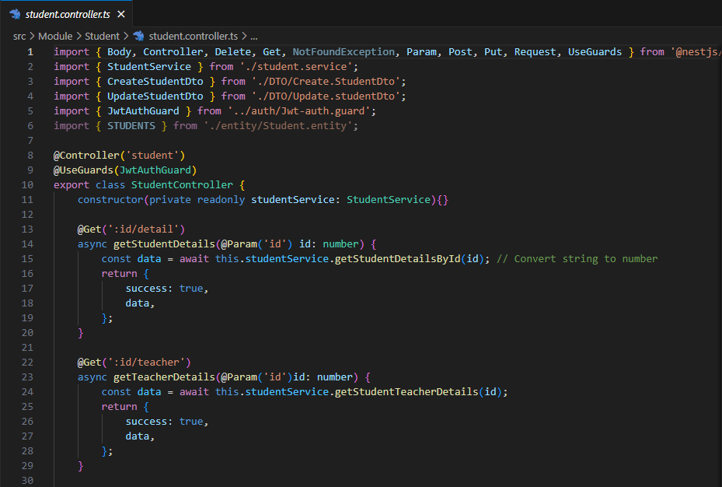
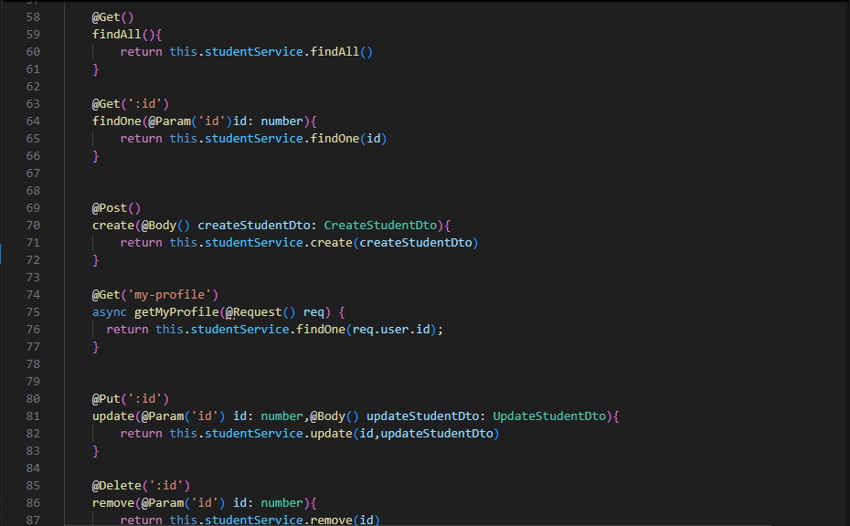
controllers

Slide 6
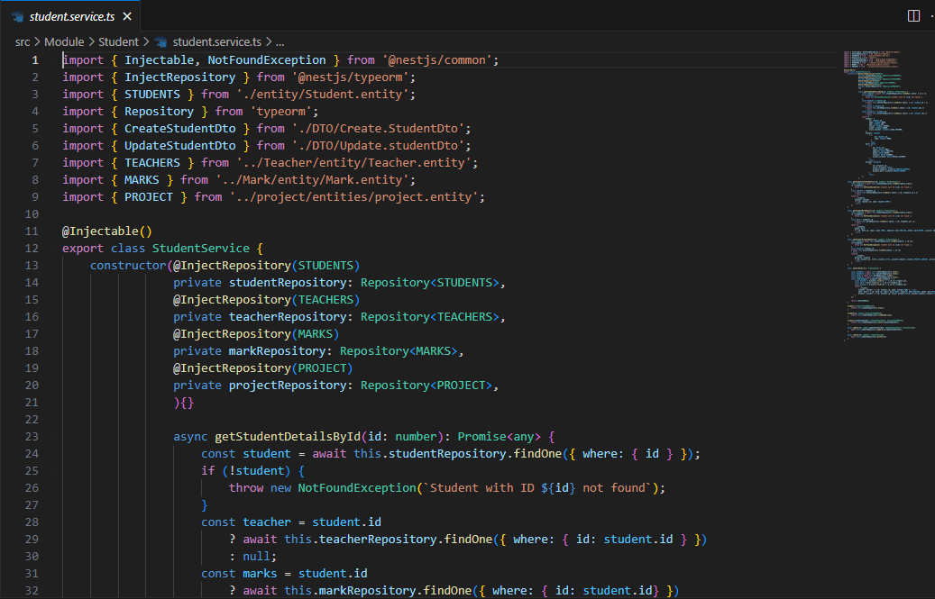
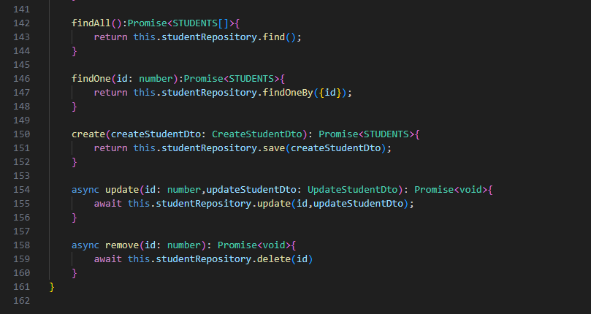
services

Slide 7
3. API Development and Enhancements
API Endpoints:
Overview of CRUD routes (e.g., create, read, update, delete).
Database Integration:
Connecting to a database (e.g., SQL SERVER) using ORM like TypeORM.
Authentication and Authorization:
JWT-based authentication for secure access.
Advanced Features:
Pagination, filtering, and sorting.
Error handling and logging.

Slide 8
4. Backend Implementation and Integration
Modules and Architecture:
Modular approach with clearly defined responsibilities for each module.
Examples: Student, Teacher, Marks and Ptoject modules.
Controller and Service Integration:
Explanation of how controllers handle requests and delegate logic to services.
Use of dependency injection to integrate services.
Database Operations:
CRUD operations using TypeORM.
Relationships between entities (e.g., linking Teachers, Students, Marks and Project).

Slide 9
Middleware and Interceptors:
Custom middleware for logging or request transformation.
Interceptors for handling responses or exceptions.
Authentication and Authorization:
Implementing JWT for secure user authentication.
API Features:
Advanced endpoints for searching, filtering, or bulk updates.
API documentation using Swagger for ease of integration.

Slide 10
5. Project Outcomes and Learnings
Outcomes:
Fully functional backend with secure APIs.
Seamless backend integration.
Learnings:
Better understanding of NestJS fundamentals.
Handling database operations with ORMs.
Secure authentication.
Practical exposure to full-stack development.

